Slide 1
Functions, Scoping and Abstraction
Unit-2

Slide 2
Content-
Declaring, Defining and Invoking a Function,
Function Specification, Function arguments: keyword, default, positional, variable-length
Local v/s Global variables

Slide 3
Types of functions in python-
There are three types of functions in Python:
Built-in functions, such as help() to ask for help, min() to get the minimum value, print() to print an object to the terminal etc.
User-Defined Functions (UDFs), which are functions that users create to help them out;
Anonymous functions, which are also called lambda functions because they are not declared with the standard def keyword.

Slide 4
Declaring, Defining and Invoking a Function-
The four steps to defining a function in Python are the following:
Use the keyword def to declare the function and follow this up with the function name.
Add parameters to the function: they should be within the parentheses of the function. End your line with a colon.
Add statements that the functions should execute.
End your function with a return statement if the function should output something. Without the return statement, your function will return an object None.

Slide 5
Continue..
Syntax of Python Function
def name_of_function( parameters ):
""“Python Programming"""
# code block

Slide 6
Declaring and defining a user-defined function-
We will define a function that when called will return the square of the number passed to it as an argument.
def square( num ):
"""This function computes the square of the number. """
return num**2
ans= square(9)
print( "The square of the number is: ", ans)

Slide 7
Calling a Function
A function is defined by using the def keyword and giving it a name, specifying the arguments that must be passed to the function, and structuring the code block.
After a function's fundamental framework is complete, we can call it from anywhere in the program.

Slide 8
Example-
# Defining a function
def a_function( string ):
"This prints the value of length of string"
return len(string)
# Calling the function we defined
print( "Length of the string Functions is: ", a_function( "Functions" ) )
print( "Length of the string Python is: ", a_function( "Python" ) )

Slide 9
Function Arguments
The following are the types of arguments that we can use to call a function:
Default arguments
Keyword arguments
Required arguments
Variable-length arguments

Slide 10
Default Arguments
A default argument is a kind of parameter that takes as input a default value if no value is supplied for the argument when the function is called. Default arguments are demonstrated in the following instance.
# defining a function
def function( num1, num2 = 40 ):
print("num1 is: ", num1)
print("num2 is: ", num2)
# Calling the function and passing only one argument
print( "Passing one argument" )
function(10)

Slide 11
Continue..
# Now giving two arguments to the function
print( "Passing two arguments" )
function(10,30)
Output-
Passing one argument
num1 is: 10
num2 is: 40
Passing two arguments
num1 is: 10
num2 is: 30

Slide 12
Keyword Arguments
The arguments in a function called are connected to keyword arguments. If we provide keyword arguments while calling a function, the user uses the parameter label to identify which parameters value it is.
# Defining a function
def function( num1, num2 ):
print("num1 is: ", num1)
print("num2 is: ", num2)
# Calling function and passing arguments without using keyword
print( "Without using keyword" )
function( 50, 30)
# Calling function and passing arguments using keyword
print( "With using keyword" )
function( num2 = 50, num1 = 30)

Slide 13
Continue..
Output:
Without using keyword
num1 is: 50
num2 is: 30
With using keyword
num1 is: 30
num2 is: 50

Slide 14
Required Arguments
The arguments given to a function while calling in a pre-defined positional sequence are required arguments. The count of required arguments in the method call must be equal to the count of arguments provided while defining the function.
We must send two arguments to the function function() in the correct order, or it will return a syntax error, as seen below.

Slide 15
Example-
# Function definition is here
def printme( str ):
"This prints a passed string into this function"
print str
return;
# Now you can call printme function
printme()
Output-TypeError: printme() takes exactly 1 argument (0 given)

Slide 16
Variable-Length Arguments
We can use special characters in Python functions to pass as many arguments as we want in a function. There are two types of characters that we can use for this purpose:
*args -These are Non-Keyword Arguments below is example-
def func(*args):
#
# here is the body of the function
#
**kwargs - These are Keyword Arguments.

Slide 17
Example-
def sum(*args):
resultfinal = 0
#beginning of for loop
for arg in args:
resultfinal = resultfinal + arg
return resultfinal
#printing the values
print(sum(10, 20)) # 30
print(sum(10, 20, 30)) # 60
print(sum(10, 20, 2)) # 32

Slide 18
Lamda Function-
Lambda Functions in Python are anonymous functions, implying they don't have a name. The def keyword is needed to create a typical function in Python, as we already know. We can also use the lambda keyword in Python to define an unnamed function.
Syntax of Python Lambda Function
lambda arguments: expression

Slide 19
Example of Lambda Function in Python
add = lambda num: num + 4
print( add(6) )
The lambda function is "lambda num: num+4" in the given programme. The parameter is num, and the computed and returned equation is num +4.
There is no label for this function. It generates a function object associated with the "add" identifier. We can now refer to it as a standard function.

Slide 20
Local and Global variables-
Global variables are those which are not defined inside any function and have a global scope whereas local variables are those which are defined inside a function and its scope is limited to that function only.
In other words, we can say that local variables are accessible only inside the function in which it was initialized whereas the global variables are accessible throughout the program and inside every function.

Slide 21
Example (local Variable)-
def f():
# local variable
s = “Python Programming"
print(s)
# Driver code
f()

Slide 22
Example (global Variable)-
# This function uses global variable s
def f():
print("Inside Function", s)
# Global scope
s = “Python Programming"
f()
print("Outside Function", s)

Slide 23
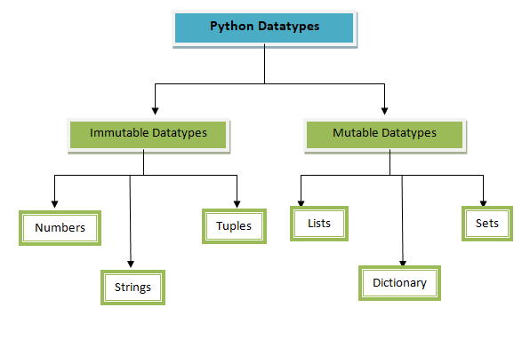
Python Datatype-

Slide 24
Immutable data structure-
These datatypes cannot be changed once declared. They consist of Numbers, Strings, Tuples.
Numbers
Python has four types of literals: Integer, Long Integer, Floating number and Complex. Even Python does not require the datatype to the variable in the declaration. Python will automatically convert one type to another datatype.

Slide 25
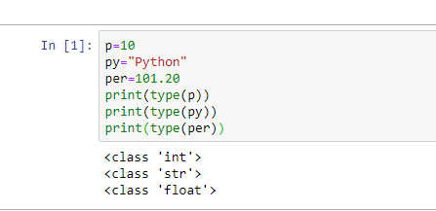
Example-
Let’s see with an example

Slide 26
Immutable data structure-
Immutable data types e.g tuples and string are the data types that cannot be further changed or modified once executed in the program.
Immutable data structures are very handy when you want to prevent multiple people from modifying a piece of data in parallel programming at the same time.
Tuples in python
Tuples are the collection of python objects separated by commas. Tuples are similar to the list in terms of indexing, repetition, and nested objects. But here, the list is mutable and can be changed further according to the need of the programmer.

Slide 27
Example-
Python program to change the value inside the tuple
# Python contains the immutable tuple
t = ( 0, 1, 2, 3, 4, 5 )
print(t)
t[0]=3
print(t)
Output-TypeError: 'tuple' object does not support item assignment.

Slide 28
Example-
Python program to delete the value inside the tuple
# Python contains the immutable tuples
t=(12, 13, 15, 2, 7, 9)
print(type(t))
print(t)
del t[0]
print(t)
Output-TypeError: 'tuple' object doesn't support item deletion.

Slide 29
Example-
Python program to delete the whole tuple
t=(12, 13, 15, 2, 7, 9)
print(type(t))
print(t)
del t
print(t)

Slide 30
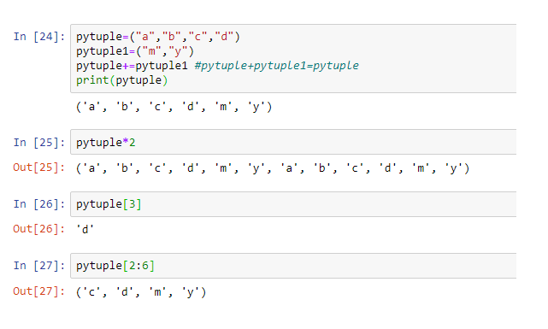
Example-

Slide 31
Immutable data Structure-
String in Python-
Python string is the collection of the characters surrounded by single quotes, double quotes, or triple quotes. The computer does not understand the characters; internally, it stores manipulated character as the combination of the 0's and 1's.
Each character is encoded in the ASCII or Unicode character. So we can say that Python strings are also called the collection of Unicode characters.
In Python, strings can be created by enclosing the character or the sequence of characters in the quotes. Python allows us to use single quotes, double quotes, or triple quotes to create the string.

Slide 32
Example-
str = "Hi Python !"
Here, if we check the type of the variable str using a Python script
print(type(str)), then it will print a string (str).

Slide 33
Example-
#Using single quotes
str1 = 'Hello Python'
print(str1)
#Using double quotes
str2 = "Hello Python"
print(str2)
#Using triple quotes
str3 = '''''Triple quotes are generally used for
represent the multiline or
docstring'''
print(str3)

Slide 34
Output:
Hello Python
Hello Python
Triple quotes are generally used for
represent the multiline or
docstring

Slide 35
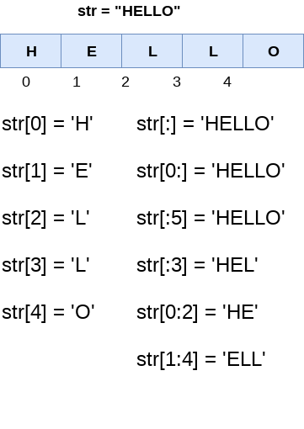
Example-
In Python, the slice operator [] is used to access the individual characters of the string. However, we can use the : (colon) operator in Python to access the substring from the given string. Consider the following example.

Slide 36
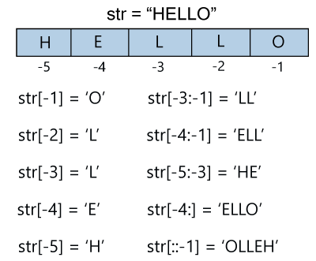
Example-

Slide 37
Example-
Reassigning Strings
A string can only be replaced with new string since its content cannot be partially replaced. Strings are immutable in Python.
str = "HELLO"
str[0] = "h"
print(str)
TypeError: 'str' object does not support item assignment

Slide 38
Example-
str = "HELLO"
print(str)
str = "hello"
print(str)
Output:
HELLO
hello

Slide 39
Deleting the String
str1 = “Python"
del str1
print(str1)
Output:
NameError: name 'str1' is not defined

Slide 40
String Operators
Operator | Description
+ | It is known as concatenation operator used to join the strings given either side of the operator.
* | It is known as repetition operator. It concatenates the multiple copies of the same string.
[] | It is known as slice operator. It is used to access the sub-strings of a particular string.
[:] | It is known as range slice operator. It is used to access the characters from the specified range.
in | It is known as membership operator. It returns if a particular sub-string is present in the specified string.
not in | It is also a membership operator and does the exact reverse of in. It returns true if a particular substring is not present in the specified string.
r/R | It is used to specify the raw string. Raw strings are used in the cases where we need to print the actual meaning of escape characters such as "C://python". To define any string as a raw string, the character r or R is followed by the string.
% | It is used to perform string formatting. It makes use of the format specifiers used in C programming like %d or %f to map their values in python. We will discuss how formatting is done in python.

Slide 41
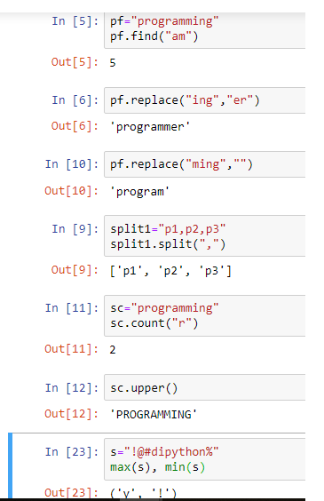
Python String functions-

Slide 42
Mutable Data Structure-
These data types can be changed anytime. They consist of Lists, Dictionary, and Sets.
Lists in python-
A list is a mutable Python data type that is defined within the []-square brackets. This group of values can be easily changed. First, we will define a list variable having multiple datatypes of values in it. Check-in In[28].
There are also some operations applied on the list,

Slide 43
Python List functions-
There are also some operations applied on the list,
Concatenation
Used to add two or more lists/elements together, as we learned in tuples.
Repetition
It’s used to duplicate a list a given number of times.
Slicing
Same as tuples, if you want the specific set of the list mentioned the starting index number and ending number+1, and it will return the sliced list

Slide 44
Python List functions-
Append
For adding value to a list.
Extend
It’s another function as concatenation.
Insert
By using the index value you can specify any value in between the list.

Slide 45
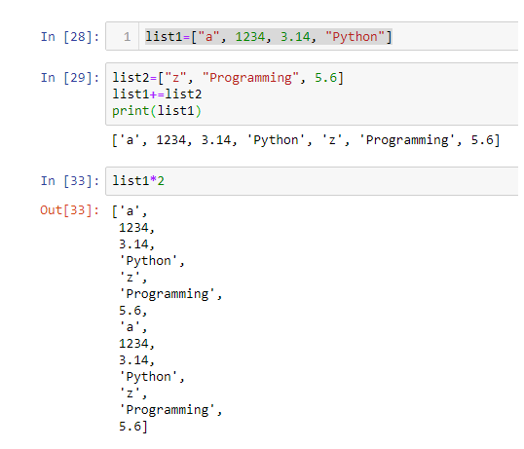
Example-

Slide 46

Example-

Slide 47
Mutable Data Structure-
Dictionary in python-
Python Dictionary is a group of values within a {} -curly braces. While defining a value, there are two elements: Key, and its Value, or we can say like we define an index for each element.

Slide 48
Dictionary Functions-
emptyDictionary
There is no value inside the dictionary.
Integer key
Key values in the dictionary are integer only.
Mixed key
There are mixed types of keys used in the Dictionary.
Pairing
This is a sequence where each item has a pair.

Slide 49
Continue..
Accessing dictionary
You can access the dictionary by directly using a key.
len()
If I want to find the Length of the Dictionary, I will use this function. It will return the output in numeric as the number of elements is there in Dictionary.
value()
Returns all the values inside the dictionary.
key()
If I want to find the key to my dictionary, then I will choose this function.

Slide 50
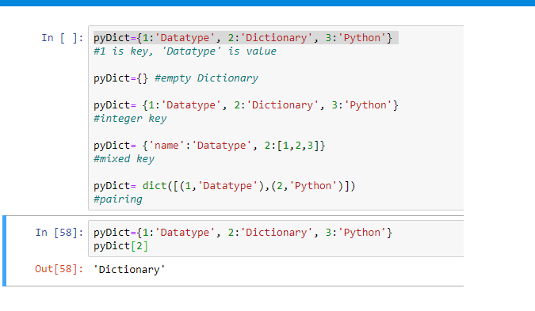
Example-

Slide 51
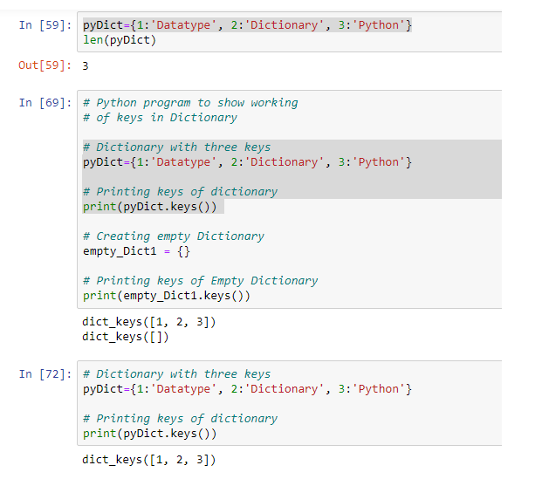
Example-

Slide 52
Mutable data structure- Sets
Sets-
Sets are the unordered collection of items within the curly braces {}. Every element in the set is unique and we don’t need to define the key-value to that element.
For example, pySet={1,2,3}: All the elements are different and they don’t consist of any key-value. It’s the only difference between set and dictionary.

Slide 53
Sets Functions-
Creating a set
Union
When we create two sets, it returns a common value from both sets.
Intersection
Returns the common element from both sets.
Difference
Omits all common values from both sets. It will return only that value which is unique and written in the first set.

Slide 54

Example-

Slide 55
Variable length keyword arguments
#program to demonstrate **kwargs in python
def my_func(**kwargs):
for k,v in kwargs.items():
print("%s=%s"%(k,v))
#passing the parameters in function
my_func(a_key="Let",b_key="us",c_key="study",d_key="Data Science",e_key="and",f_key="Blockchain")

Slide 56
Output:
a_key=Let
b_key=us
c_key=study
d_key=Data Science
e_key=and
f_key=Blockchain

